Slide 1
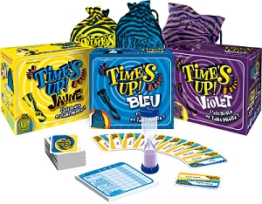
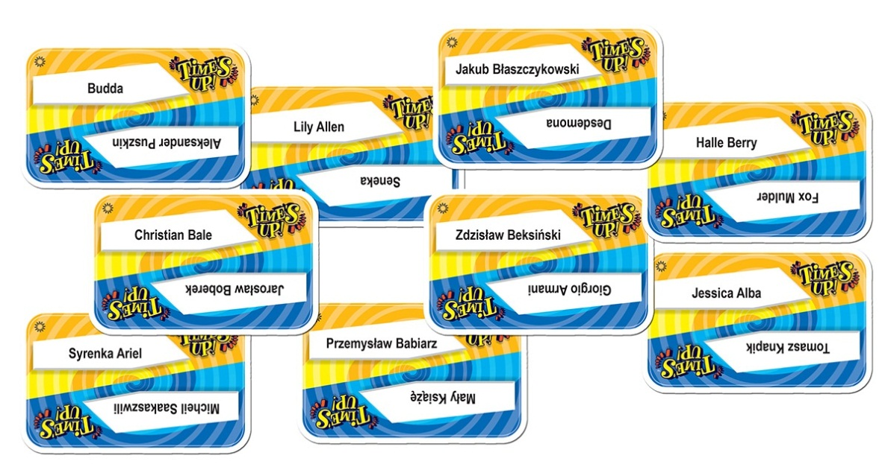
Rules of the game Tim’s Up
The game is played using a set of 40 randomly chosen name cards, known as the Deck of Fame. The Deck of Fame is used throughout all three rounds of the game. Each team gets 30 seconds to guess as many names as possible, with one player giving clues to his teammates. Players use words, sound effects and charades as they give their clues, but speech becomes more restricted as the game progresses in rounds 2 and 3. On each team's turn, one member of the team is the Cluegiver and the rest are the Guessers.
In round 1, the Cluegiver draws a name card and begins giving clues to his teammates (Guessers). Almost anything is allowed for cluegiving, but passing is not allowed. The Cluegiver can sing, hum, point, charade, give full descriptions of the person, etc. The round ends when all names have been guessed.
In round 2, the Cluegiver may give only one word for each clue, which may be repeated as often as desired. Once the word is said, only non-verbal clues (sound effects, charades) may be given. Teammates get one guess only, and passing is allowed.
In round 3, the Cluegiver may not use any words at all. Only sounds and charades may be used for each clue. Teammates get one guess only and passing is allowed.

Slide 2
Napoléon
Iker Casillas
Abraham Lincoln
Bilbo the Hobbit
The Lion King
Astérix
Obélix
Tintin
Mad Max
Mika
Columbo
Shakira
Justin Timberlake
Zeus
Luke Skywalker
Pikachu
Transformers
Largo Winch
Mario
Youtube
David Guetta
Snow white
Zidane
Teenage Mutant Ninja Turtles
Twitter
Marco Polo
Barack Obama
Big Ben
Pinocchio
Star Wars
Tinder
Mickey Mouse
Al Capone
Lego
Eddie Murphy
Jim Carrey
Beyoncé
Tiger Woods
Catwoman
Batman
Christian Dior
Scarface
Rambo
The Joker
Schtroumpf
Chuck Norris
Davy Crockett
Pythagore
Hercule
Alice wonderland
Sylvester Stalone
Marion Cotillard
Dexter
Leonardo DiCaprio
Nicolas Sarkozy
Corto Maltese
Paolo Coehlo
Pelé
Messi
Ronaldo
The Rolling Stones
Lou Bega
Mark Zuckerberg
Ali Baba
WALL-E
E.T
Bill Gates
Rihanna
Jules Verne
Marilyn Manson
Titeuf
Julia Roberts
Ben Stiller
The White house
Legolas
The China wall
Candy Crush

Slide 3
Tetris
Hakuna matata
The Lion King
Jules César
Superman
Pocahontas
Rafael Nadal
The Eiffel Tower
Naruto
Sangoku
Mariah Carey
Che Guevara
Michael Jackson
Very Bad Trip
Robinson Crusoé
Pokemon
Statue of Liberty
Paranormal Activity
Call of duty
Spock
Britney Spear
Hannibal Lecter
Adolf Hitler
Popeye
Jules Ferry
Ulysse
Miley Cyrus
Olaf
Roméo & Juliette
Michael Jordan
Tom Cruise
Sonic
Attila
Madagascar
Madonna
François Hollande
Léonard De Vinci
Shéhérazade
The Voice
Assassin’s Creed
Hello Kitty
Daft Punk
Isaac Newton
Zombie
Captain Jack Sparrow
Monica Belluci
Steven Spielberg
Esmeralda
Lucky Luke
Snoop Dogg
Aladdin
Robin Hood
Titanic
Shrek
Hulk
Captain America
Spiderman
Ra
Jennifer Lopez
Miss world
Stromae
Rocky
Albert Einstein
Star Trek
American Pie
Kung Fu Panda
La Joconde
Charmed
Dora
Peter Pan
Buzz Lightyear
La vache qui rit
Eminem
Ramsès
X-Men
Twilight
Pac-Man

Slide 4
Homer Simpson
Nirvana
Louis Vuitton
Gladiator
One Piece
Marie Curie
Néfertiti
Alien
300
Gangnam Style
Snoopy
Walt Disney
Chewbacca
Santa Claus
Bob Marley
Johnny Depp
The Minions
Gandalf
Elton John
Jurassic Park
Arnold Schwarzenegger
Stephen King
Marilyn Monroe
Jon Snow
Mozart
Indiana Jones
Jessica Alba
Dare Devil
Jet Li
Zlatan Ibrahimovic
Michael Schumacher
Vin Diesel
Flash McQueen
Victor Hugo
Selena Gomez
Robocop
Dalaï-Lama
AC/DC
George Clooney
Angela Merkel
The Walking dead
Gengis Khan
Fidel Castro
George W.Bush
Oussama Ben Laden
Ho Chi Minh
Shakespeare
Elvis Presley
Joseph Staline
Pablo Picasso
Confucius
Vladimir Poutine
Lady Diana
Gandhi
Nelson Mandela
Victor Hugo
Barbie
Albator
Athena
Avatar
Iron Man
Deadpool
Chun Li
Chucky
Street Fighters
Death note
Donald Duck
Dumbo
Frozen
Tomb Rider
Mulan
Sherlock Holmes
Wolverine
Donald Trump
Buddha
DragonBall Z
Bruce Willis

Slide 5
Lady Gaga
Elvis Presley
Paris Hilton
Louis Paster
Aristote
Martin Luther
Karl Marx
John Dalton
Alexandre le Grand
Ludwig van Beethoven
Jules César
Voltaire
Bambi
Cinderella
Zorro
Dr. Flubber
The Jungle Book
Tarzan
Inspector Gadget
Ratatouille
Prince of Persia
Rapunzel
Ariel
Woody
Captain Hook
Green Arrow
A Ninja
A Samurai
Yann Solo
Brad Pitt
Tom Cruise
Hadès
Rayman (game)
Ronaldinho
Usain Bolt
Robin Williams
David Cameron (UK)
Larry Page [Google]
Thor
Jackie Chan
The Mask
Aung San Suu Kyi
Kurt Cobain
Julia Roberts
Hillary Clinton
Tom Hanks
Poséidon
Michelle Obama
Princess Leila
Bruce Lee
Ben Aflleck
Cupidon
Zombie
The Minautore
Soldier Ryan
Queen Elizabeth II
Céline Dion
Titan
George Clooney
Avenger
Will Smith
Madonna
Taylor Swift
Clint Eastwood
Ariane
Terminator
Duke Nuken
Harry Potter
Robert De Niro
Kim Jong Un
David Beckham
Aretha Franklin
Lalou (the fifth Element)
Morgan Freeman
Werewolf
SIMS
Angelina Jolie

Slide 6
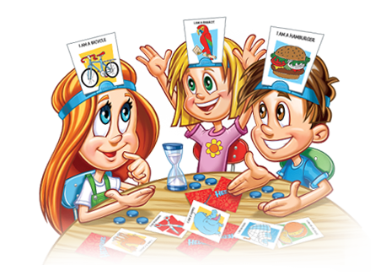
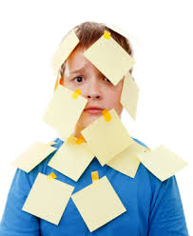
HEDBANZ
Object of the Game
The first player to get rid of all of his or her chips wins!
Play
The youngest participant takes the first turn. Then play passes to the left.
When it’s your turn, just flip over the timer and ask each of the players a question that will help you figure out what the picture is on your head.
Once you’ve asked each player a question, simply begin another round and then another.
The question cards provide examples of the types of questions that you could ask to help you figure out what the picture is on your head. No one has to follow the sample questions exactly, but players are not allowed to ask, “What am I?”. However they may ask, “Am I a…?”
If you guess the picture before the timer runs out, simply take another card and put it behind your headband. Continue to ask questions until the timer runs out. For each picture that is guessed correctly, you simply put one of your chips into the “bank”, signaling the end of your turn.
Players are always free to give up guessing at any point during their turn. But if that player does give up, they must take a chip from the bank!
Set Up
Place each of the cards face down in the middle of the playing area.
Each player then takes a headband and adjusts it around his or her head. If you don’t have headbands, just use “post it”.
Deal out one card, facedown, to each participant. Players then place each card into the clip of his or her headband (or “post it”). Be sure not to look at it as you put it in the headband! All other players must be able to see the picture.
Each player gets three chips, to be handed out by dealer. Any leftover chips become the “bank”‘s property.
“Post it”

Slide 7
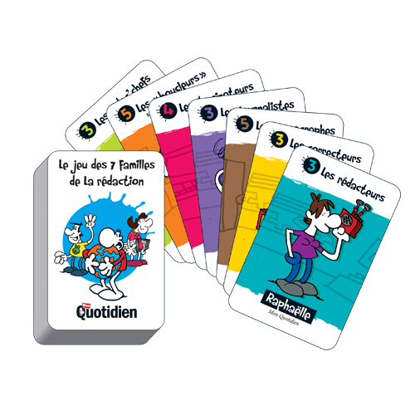
Happy families – Rules of the game
From 2 to 4 players.
The idea of the game is to collect whole families. The dealer deals 6 cards to each player (8 each for 2 players). The remaining cards are placed face down to form a stock. The player to dealer's left starts. A turn consists of asking a specific player for a specific card from a family. For example, if it is my turn I might say: 'Mary, Blue family: please, can I have the mother? The player who asks must already hold at least one card of the requested family, so I must hold at least one card from the blue family to say this. If the player who was asked (Mary) has the right card in her deck (the mother from the Blue family in this case), she must give it to the player who asked for it. That player then gets another turn and may again ask any player for any card already held by the asker. If the person asked does not have the right card, she says “pick a card!”. The asker must then draw the top card of the undealt stock. If the drawn card is the one asked for, the asker shows it and says “lucky dip” and gets another turn. If the drawn card is not the one asked for, the asker keeps it, but the turn now passes to the next player. As soon as a player collects a book of 4 (6) cards of the same family, he must say “happy family”. The cards must be shown and then placed face down. The game continues until either someone has no cards left in hands or the stock runs out. The winner is the player who then has the most families.

Slide 8



Start Up Rules
All cards in the deck (minus jokers) are dealt out clockwise, one at a time, starting with the Asshole (loser of the last game.)
Object of the Game
The object of the game is to get rid of all your cards before anyone else, the first one to do so is President. The last person to do so is labeled the Asshole.
General Gameplay
The order of cards from lowest to highest is 4, 5, 6, 7, 8, 9, 10, J, Q, K, A, with 2 and 3 being special cards. The suite of the card does not matter in this game. A pair of any kind is higher than a single (so two 3's is higher than a single ace), any triple higher than any double, etc. Four of a kind will clear the round.
Roles in the Game
President The last person who won is the President. This means that you will get to give your worst card to the Asshole in exchange for their best. You may also make anyone drink at anytime for anything you want to. Depending on the rules you may have to win a certain number of games before you can become the official President.
Asshole You where the last person with cards in the previous round. This means you must deal, clear the cards, as well forfeit your best card to the President in exchange for their worst.
This card is a clear, no matter what is played this card clears the round and the person who uses it goes again with a fresh round.
This is a wild card or two 3's played is a clear. A player may choose its value to be anything except a 2. Note that this card DOES NOT take the place of a natural card (to skip a player or count towards the completing of a number set.)
If player A play the card “7” (Or any other card expet « 2 »), player B can play the same number and skip player C.

